Slide 1
ANALYSIS OF NIFTY50
Presented by
Group 14
Yuvraj Singh
Swobhineet Swain
Rohit Kumar
Priyanshu Bansal

Slide 2
TABLE OF CONTENT
Data Analysis :
Company-Level
Overview
Data Cleaning
Data Analysis:
Sector-Level
Conclusion

Slide 3
OVERVIEW
The NIFTY50 index is a benchmark stock market index representing the top 50 companies listed on the National Stock Exchange (NSE) of India. This project aims to analyze historical data of the NIFTY50 index from 2000 to 2021, with the goal of deriving meaningful insights about market trends, volatility, and the performance of key sectors over time.

Slide 4
DATA DICTIONARY
Key Columns:
Date: Trading date.
Symbol: Stock ticker symbol.
Prev Close, Open, High, Low, Last, Close: Various price metrics.
VWAP: Volume Weighted Average Price.
Volume: Number of shares traded.
Turnover: Total value of traded shares.
Trades: Number of trades (partially populated).
Deliverable Volume: Shares delivered (partially populated).
%Deliverable: Percentage of deliverable shares.

Slide 5
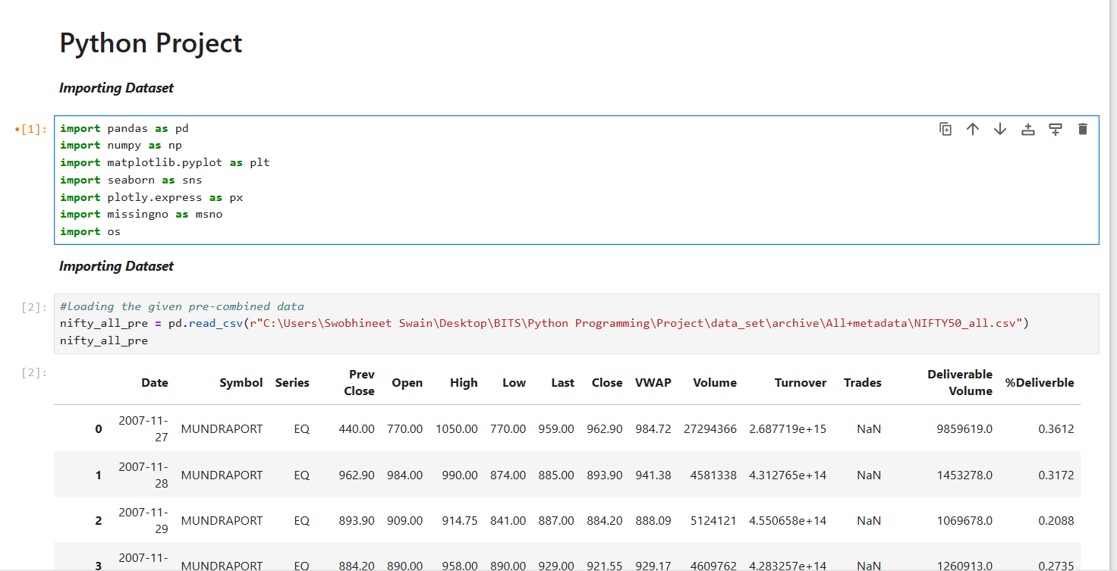
IMPORTING DATA

Slide 6
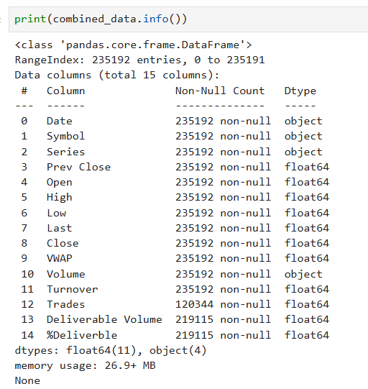
DATA DESCRIPTION
We have imported all the csv files for
50 companies to match the data
included in NIFTY_50 using Data Wrangler .
Through .info(), we have checked for the Null Count & found 50% of Data for Trades are NA .
Null values are not removed to avoid losing significant data, which could bias the analysis and insights

Slide 7
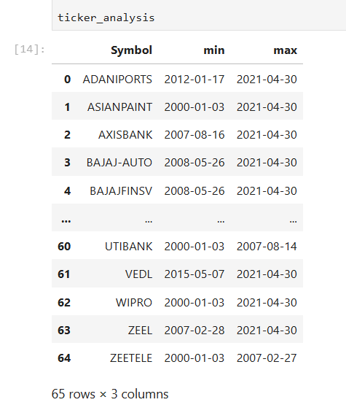
CLEANING DATA
There is no data available in one company , i.e Bharti Infratel Ltd.
TICKER ANALYSIS :
There is total 65 unique tickers in NIFTY_50 data
However , there are only 49 unique_tickers in Meta_data .

Slide 8
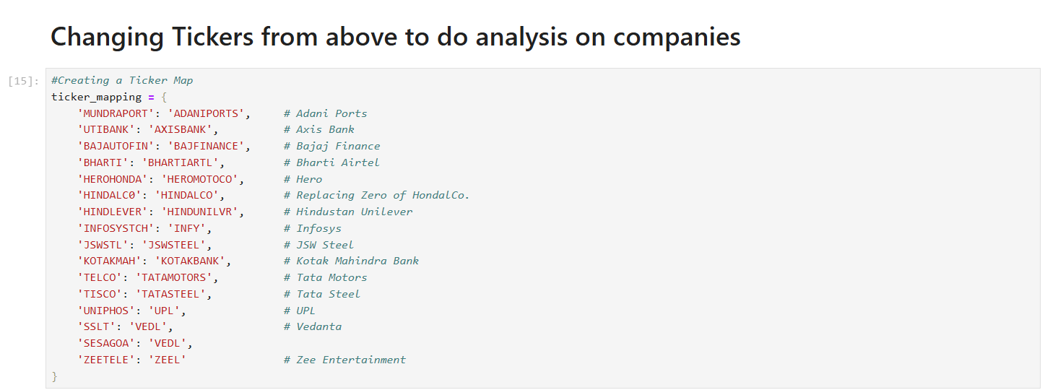
CLEANING DATA

Slide 9
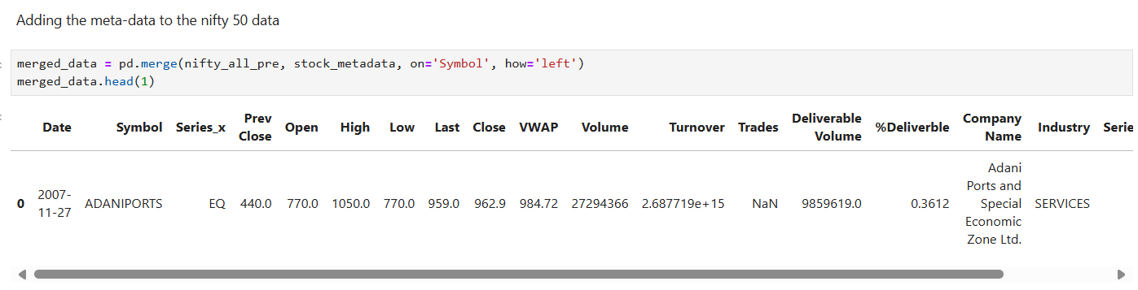
MERGING DATA
We have merge the Meta_Data to Nifty_50 data to include Company Name and Industry in NIFTY_50 data for using in Data Visualization and Insights

Slide 10
COMPANY LEVEL ANALYSIS
Market Trends
Profitable Stocks
Correlation between Performance Metrics
Converted the date column to date time (time-series) format and plotted the average closing price over time
Calculated the profit for each stock over time
Calculated the coefficient of correlation between performance metrics along with heatmap

Slide 11
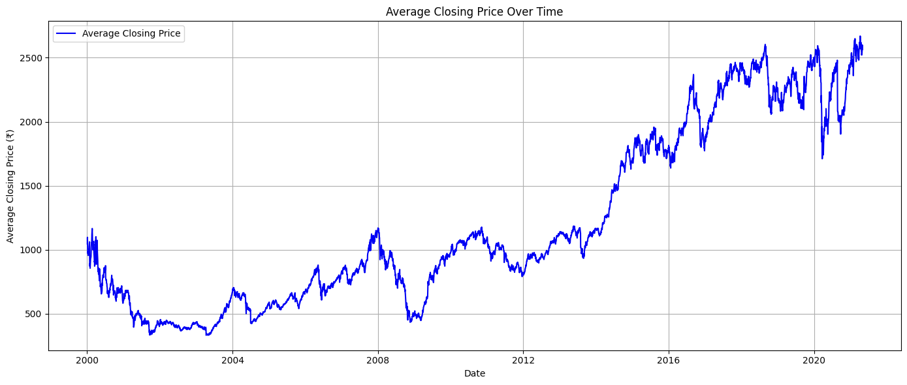
RETURN VISUALIZED

Slide 12
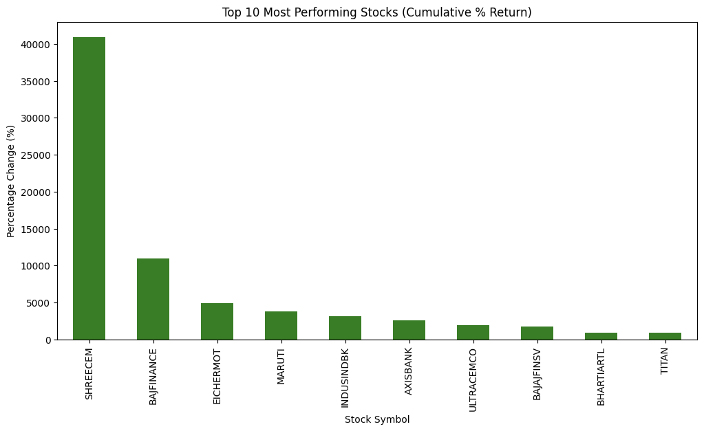
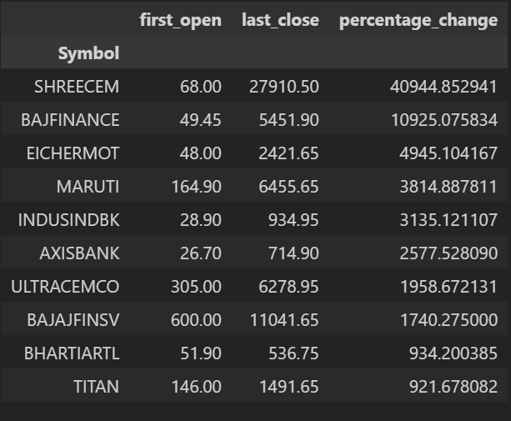
CUMULATIVE % RETURN VISUALIZED

Slide 13
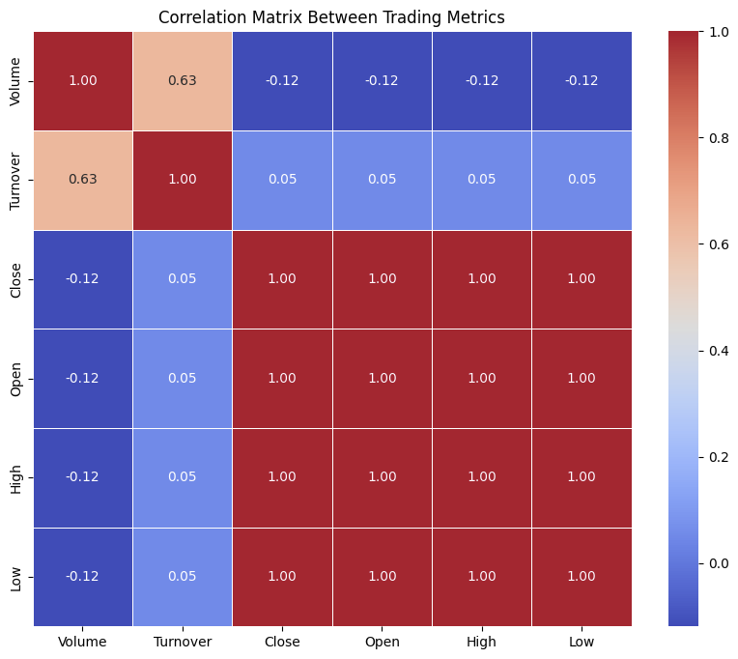
HEAT-MAP OF PERFORMANCE METRICS

Slide 14
INSIGHTS
BASED ON COMPANY LEVEL ANALYSIS
BULLISH MARKET
STOCK PERFORMANCE
STRONG CORRELATIONS
Overall market has risen (bullish)
There were 2 major dips in the market - 1) Post 2008 Financial Crisis 2) COVID-19 Pandemic
Strongest Correlations: Open, High, Low, Close
Positive Correlation between Volume and Turnover
Weak Correlations between volume and price metrics and also between turnover and price metrics.
Top Performing Stocks: Shree Cement, Bajaj Finance, Eicher Motors
High Positive Return indicate significant growth and investor confidence since IPO.

Slide 15
SECTOR LEVEL RISK AND RETURN ANALYSIS
Sector Classification
Sector-Wise Returns
Sector-Wise Risk
Grouped companies in the NIFTY50 index based on their respective sectors (e.g., IT, Finance, Energy, etc.)
Calculated the average returns for each sector using historical price data from 2000 to 2021.
Measured risk by computing the standard deviation of returns for each sector, reflecting volatility.

Slide 16
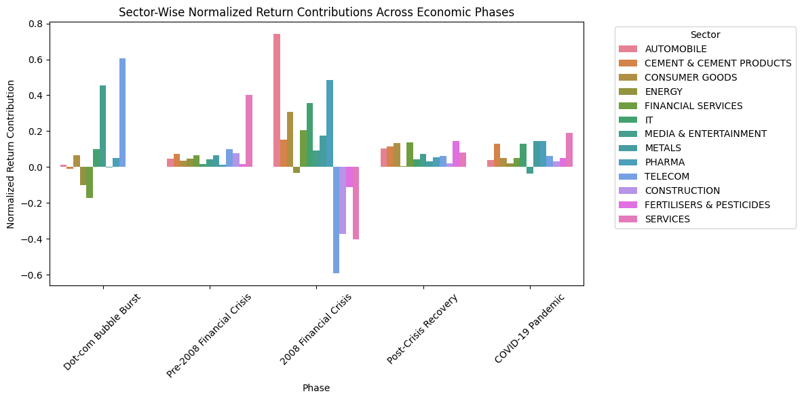
RETURN VISUALIZED

Slide 17
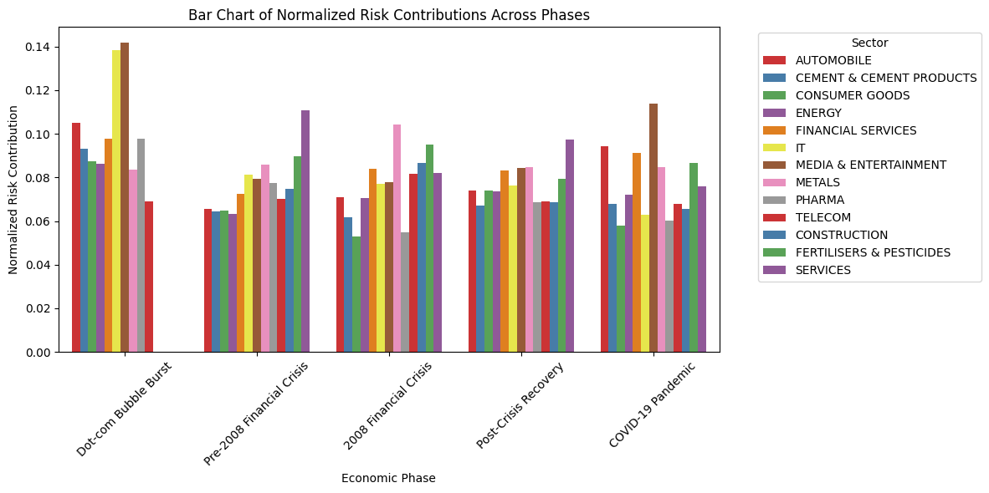
RISK VISUALIZED

Slide 18
INSIGHTS
BASED ON RISK AND RETURN ANALYSIS
HIGH-RISK APPETITE
MODERATE-RISK APPETITE
LOW-RISK APPETITE
Top Sectors: IT, Metals, Telecom
These sectors offer high returns but come with higher volatility. They are suitable for investors looking for significant growth potential and who can tolerate market downturns.
Top Sectors: Consumer Goods, Pharma, Services
These sectors consistently provide steady returns with low volatility, making them ideal for conservative investors seeking long-term stability and reliable growth.
Top Sectors: Pharma, Consumer Goods, Financial Services
These sectors provide moderate returns with moderate risk, balancing growth and stability, and are suitable for investors seeking growth without excessive risk exposure.

Slide 19
CONCLUSION
Our project succesfully analyzed sector-wise and company-level performance across major economic phases (2000-2021) using Python for data cleaning, visualization, and insights. Sector-level analysis highlighted the resilience of Pharma and Consumer Goods during crises and the growth potential of Services, Metals, and Financial Services in recovery phases. These insights guide strategic investments across sectors and companies.

Slide 20
THANK YOU

